Slide 1



Hospital Management System
Design Patterns Project
Qasim Al-Humaidi
Khalil Al-Masri
Mahmoud Nimer
Mohammed Al-Homsi

Slide 2



1. Project Overview & Problem Statement
Project Goal
The "Unsaved Progress" Problem
To simplify code usage by avoiding complex constructors with many parameters, thereby reducing code complexity and improving maintainability.
A nurse spends 20 minutes entering data for 10 patients. Suddenly:
Power outage or system crash.
Windows forces an automatic update.
Focus: Modular design and efficient object creation in a clinical environment.
Challenge: Keeping Java Swing UI (Table) and Data (List) synchronized.

Slide 3




2. Problem Analysis: Inputs & Process
Employee Info
Patient Info
The Process
ID (int), Name (String)
address (String)
1. Data Structuring
Age (int), Role (String)
fileNumber (final String)
2. Automatic Enrollment
Base Salary (double)
diagnosis (String)
3. Record Initialization
Dept, Specialization
phoneNumber (String)
4. Info Representation
Experience, Shift
bloodType, status
Linking general personal data with specialized clinical data.
Extends: Person (Base Class)
admissionDate (LocalDate)

Slide 4




3. Problem Analysis: Constraints & Trade-offs
System Constraints
Engineering Decisions
Data Integrity:
Memory vs. Persistence:
Immutable fileNumber (final), unique IDs, and mandatory fields validation.
Used LocalDate objects for easier date calculations despite higher memory
Logical & Type:
usage.
Strict typing for numeric data, JComboBox for restricted selections.
Flexibility vs. Specificity:
Operational:
Used Strings for status/bloodType to maintain quick development flexibility.
Automated time-stamping, CardLayout for view isolation.
Inheritance Choice:
Non-Functional:
Used 'extends Person' to follow DRY principle, accepting tight coupling.
Persistence only on manual save, inheritance-based structure.
Traded Code Brevity for Robustness and Readability.

Slide 5



4. Selected Design Pattern
Builder Pattern
The Builder Pattern is used to separate the construction of a complex object from its representation, allowing the same construction process to create different representations.
Applied to: Hospital Management System

Slide 6


5. Why Builder Pattern? Anti-Pattern vs. Solution
The Anti-Pattern: Telescoping Constructor
Occurs when multiple constructors are created to handle different combinations of optional parameters, leading to unreadable and fragile code.
Patient(id, name); Patient(id, name, age); Patient(id, name, age, diagnosis, bloodType, ...);
The Fit: Builder Pattern Solution
Provides a step-by-step approach to building complex objects. It separates the construction logic, making it readable, maintainable, and less error-prone.
new PatientBuilder().setId(1).setName("John").setAge(30).build();

Slide 7



6. Design Principles: SRP & Encapsulation
Single Responsibility (SRP)
Encapsulation
Construction logic is moved out of the domain class (e.g., Patient) and into a dedicated Builder class. This keeps the domain class focused solely on its primary data and business behavior.
The internal representation of the product is hidden from the client. Clients only interact with the Builder's interface, ensuring the assembly process is controlled and the final object is always in a valid state upon calling .build().
Result: Cleaner, more focused domain classes.
Result: Controlled construction & guaranteed validity.

Slide 8



7. Design Principles: OCP & Immutability
Open/Closed (OCP)
Immutability
New types of builders can be introduced to create different variations of the product (e.g., EmergencyPatientBuilder). This is achieved without modifying the existing client code or the product class itself.
The Builder pattern is an excellent way to create immutable objects. Since the object is only instantiated at the final step, fields can be made read-only once the object is built, preventing accidental state changes.
Result: Extensible system without breaking existing code.
Result: Thread-safe and robust data objects.

Slide 9

8. Pattern Comparison: Factory vs. Builder
Feature
Factory Pattern
Builder Pattern ★
Construction
Single-step call
Multi-step process
Complexity
Simple object creation
High level of configuration
Flexibility
Fixed configurations
Readable & Maintainable
Key Difference: Unlike the Factory Pattern, the Builder Pattern is essential when object creation involves a complex, multi-step process or requires high configuration flexibility (e.g., creating a Patient with many optional medical records).

Slide 10
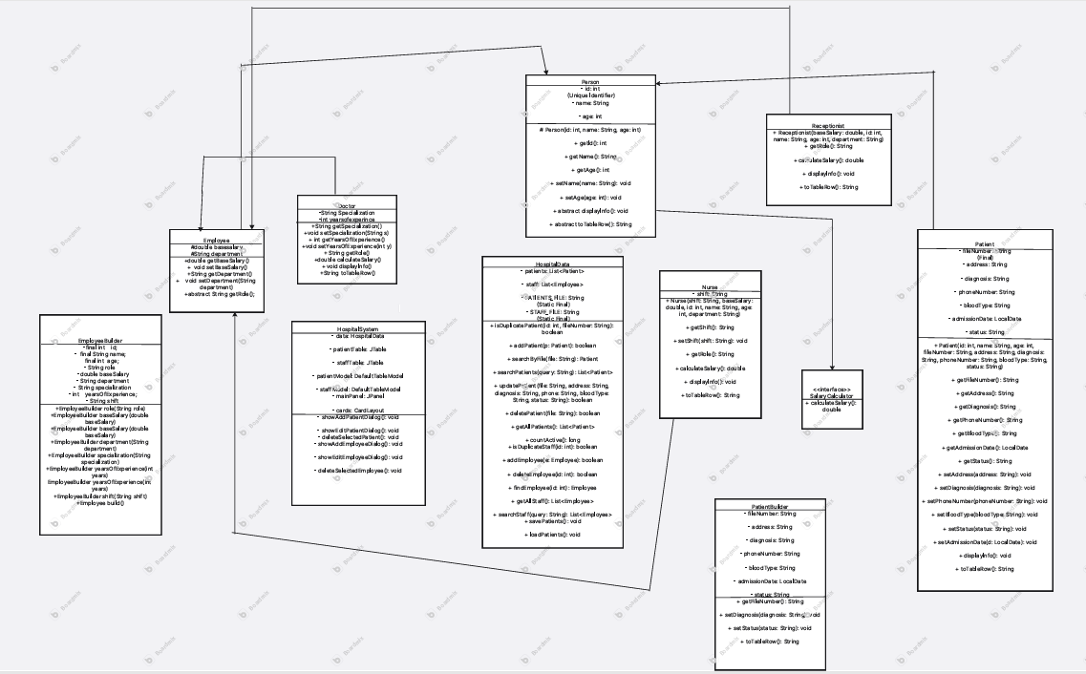
9. UML Design: System Overview & Diagram
System Overview
The Hospital Management System's architecture is designed for modularity and scalability, separating responsibilities across various entities. Below is the comprehensive UML Class Diagram illustrating these relationships.

Slide 11

10. UML Design: Builder Classes & Relationships
PatientBuilder
Concrete Builder
Director
Interface defining steps: setName(), setAge(), setDiagnosis(), setContactInfo().
Implements the interface, constructs and assembles the Patient object step by step.
Controls the building process and the order of steps for different patient types.
Relationship
Description
Association
Patient is associated with Doctor and Nurse. Appointment links Patient and Doctor.
Dependency
HospitalSystem depends on Patient, Doctor, and other classes to perform operations.
Builder
Director uses Builder to construct Patient. Builder creates and returns a Patient object.

Slide 12



11. Application Summary & Conclusion
Application of Builder Pattern
The Builder Pattern is applied to handle the construction of complex objects like Patient and related records. Instead of using large constructors, the system uses a step-by-step approach via a Builder Interface, Concrete Builder, and Director.
Cleaner Code
Design Principles
Maintainability
Eliminates the "Telescoping Constructor" trap, making the codebase more readable and less error-prone.
Strong adherence to SRP, OCP, Encapsulation, and Immutability for robust object creation.
The modular design ensures the system is scalable and easy to maintain as requirements evolve.
Link of Project

Slide 13




Thank You!
Any Questions?

